Slide 1

Artificial intelligence-based spam filtering with neurolinguistic approach using PyTorch framework
Tóth Balázs

Slide 2
CONTENTS
About the project
Hyperparameters
Data collection and preprocessing
Model architecture
Training process
Evaluation metrics
Comparisons
Further improvements

Slide 3


About the project
Stack
PyTorch, Flask (API)
Goals
Easy implementation to any application
Prevent users from malicious emails

Slide 4

Hyperparameters
Learning rate = 0.001
Epochs = 20
Optimizer type = Adam
Loss function = Cross-entropy
Classes
Spam = 1
Not Spam = 0
Notes:
Learning rate, where the rate at which the model adjusts its weight during training and also plays a crucial role in determining the convergence and stability of the training process.
Batch size, where the number of data samples used in each iteration of the training process and also it affects the speed of convergence and memory requirements.
Number of epochs, where the number of the entire dataset is passed through the model during training and it determines the duration of the training process.

Slide 5
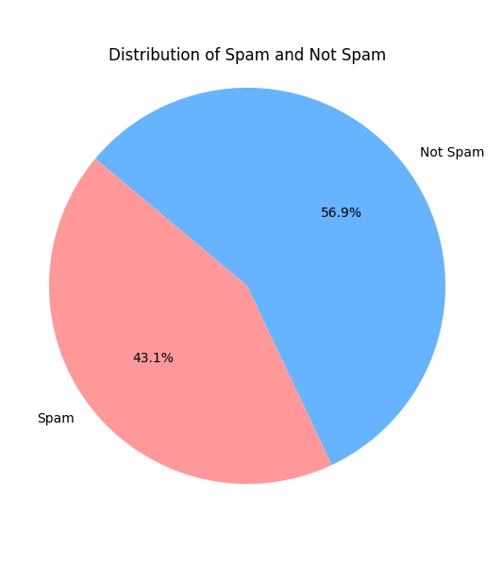
Data collection and preprocessing
Text classification labels
Text, the message
Class, the classification of the message (0 or 1)
Preprocessing
Classification
Extracting features from text (CountVectorizer)
Converting data to PyTorch tensors

Slide 6
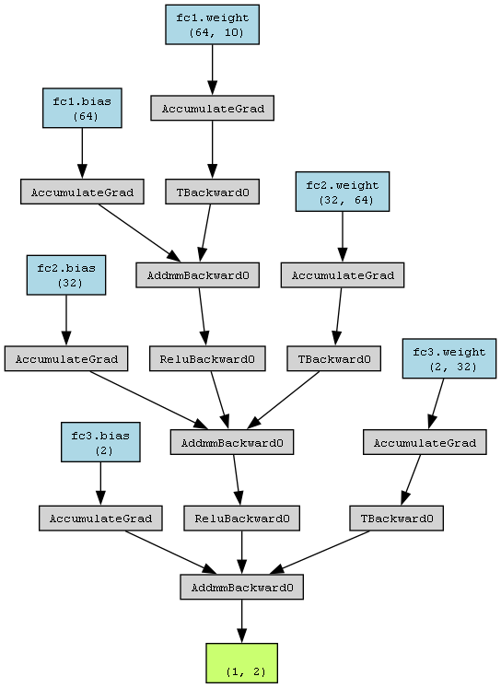
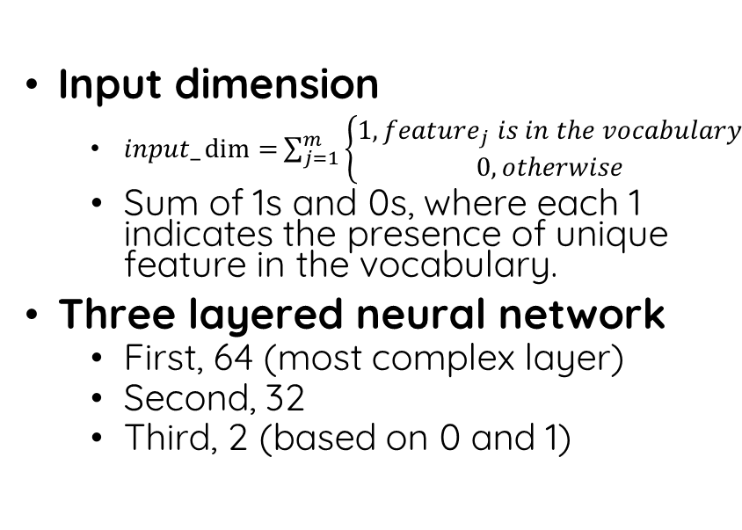
Model architecture
Input dimension
$input_\dim{=}\sum_{j=1}^{m}{\left\{\begin{aligned}1, {feature}_{j} is in the vocabulary \\ 0, otherwise\end{aligned}\right.}$
Sum of 1s and 0s, where each 1 indicates the presence of unique feature in the vocabulary.
Three layered neural network
First, 64 (most complex layer)
Second, 32
Third, 2 (based on 0 and 1)

Slide 7
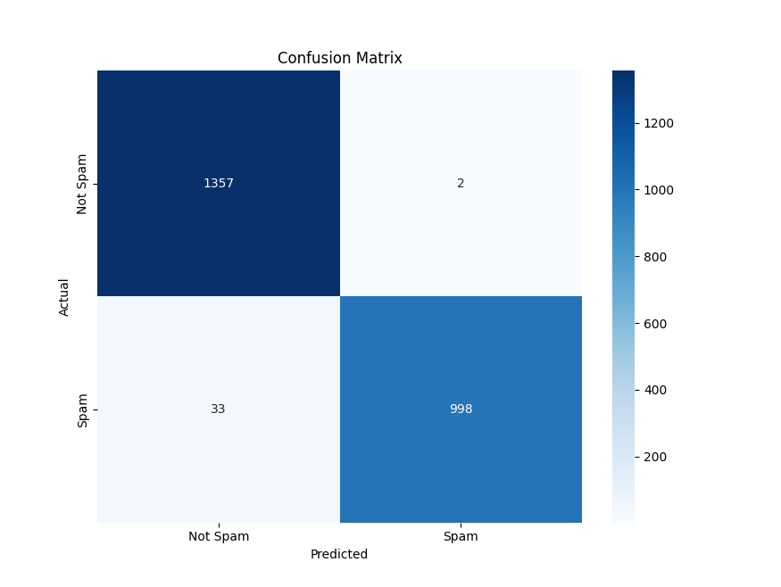
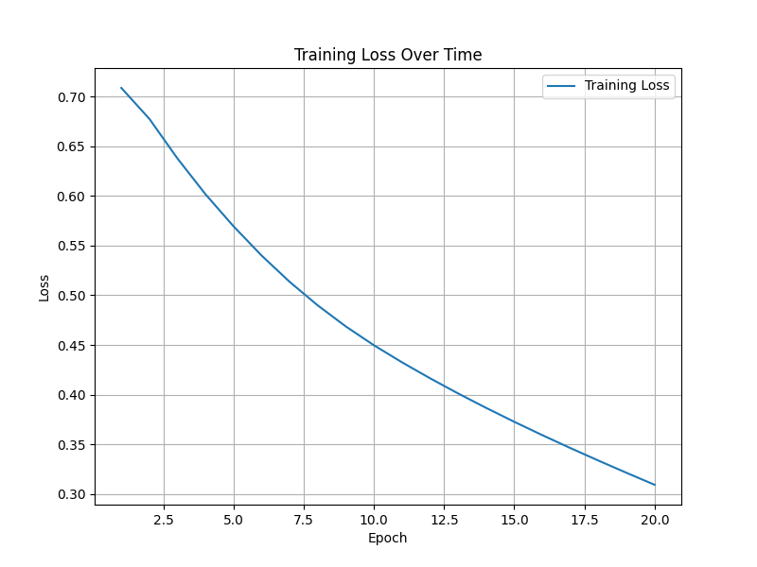
Training process

Slide 8

Evaluation metrics
Accuracy = $\frac{TP + TN}{TP + TN + FP + FN}$ = $\frac{1357 + 998}{1357 + 998 + 33 + 2}$ = 0.9853
Precision (Positive Predictive Value) = $\frac{TP}{TP+FP}$ = $\frac{1357}{1357+33}$ = 0.9762
Recall (Sensitivity, True Positive Rate) = $\frac{TP}{TP+FN}$ = $\frac{1357}{1357+2}$ = 0.9985
F1 score = 2 $×\frac{Precision × Recall}{Precision+ Recall}$ = 2 $×\frac{Precision × Recall}{Precision + Recall}$ = 0.98722

Slide 9
Comparisons

